Slide 1

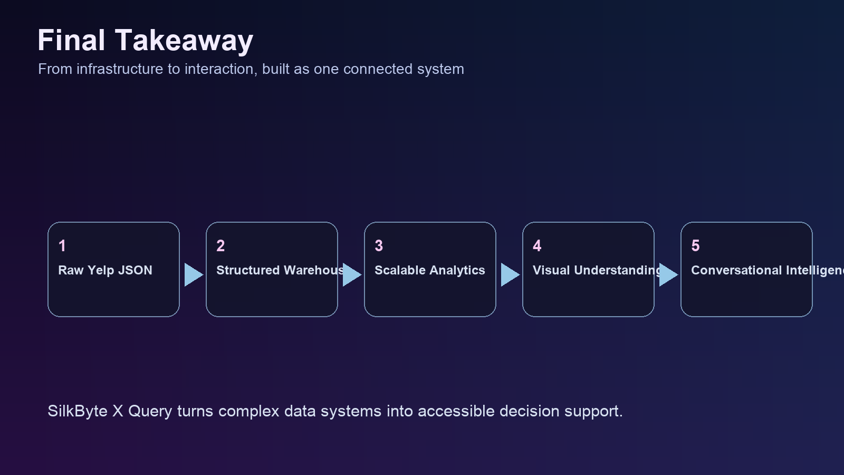

SILKBYTE X QUERY
Big Data Analytics Project Summary
Compact presentation covering the required project sections without overloading the deck.
Yelp Dataset
HDFS
Hive
PySpark
Zeppelin
Text-to-SQL
End-to-end system from raw Yelp JSON ingestion to conversational analytics.
Designed for explainable querying: question -> SQL -> result table -> chart.
Built as both a big data coursework pipeline and a product-style demo.
Project flow from storage and analytics to conversational insight
01

Slide 2
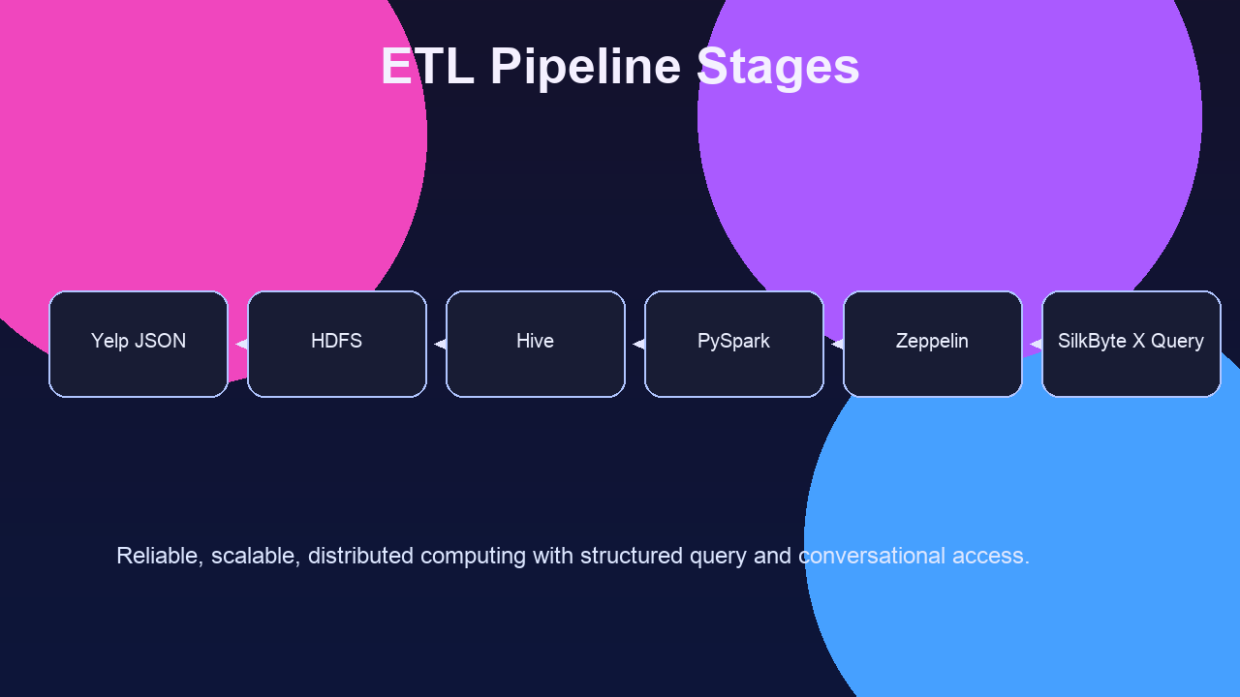
GENERAL PROJECT DESCRIPTION
What The Project Does
A unified system that converts large Yelp data into accessible business insight.
Storage
Warehousing
Processing
Visualization
AI Querying
Ingested semi-structured Yelp JSON into a scalable distributed environment.
Structured the data in Hive and processed analytical tasks with PySpark.
Used Zeppelin for notebook-based visual reporting and validation.
Added Query by SilkByteX as the conversational layer for natural-language querying.
Raw data -> warehouse -> analytics -> product layer
02

Slide 3
TEAM MODULES
Member Responsibilities
Module ownership was split by analysis domain, then integrated into one final system.
Team Division
Ownership
Integration
Sabah Laajaje: Business analysis and data enrichment.
Focused on categories, ratings, locations, top-performing businesses, and external-context hypotheses.
Fahim: User analysis and enrichment.
Focused on growth, engagement, top reviewers, elite behavior, and external influence patterns.
Mobashir Sifat: Review analysis and integration support.
Focused on review trends, sentiment-oriented interpretation, and presentation/product synthesis.
Shared team work: ETL workflow, architecture integration, Zeppelin outputs, and final delivery alignment.
03

Slide 4
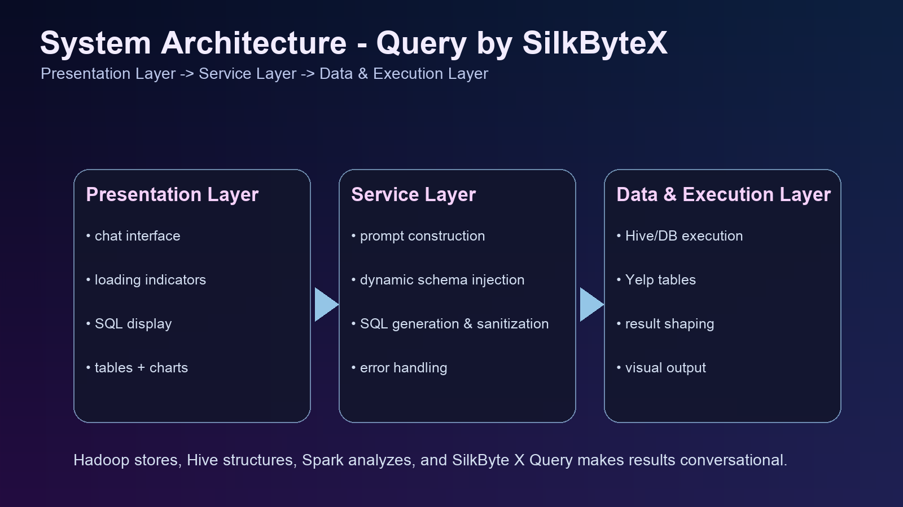
SYSTEM ARCHITECTURE
Three-Layer Architecture
The product is organized as presentation, service, and data-execution layers.
Streamlit UI
Pipeline
LLM
Hive/Spark
Schema Injection
Presentation layer in ui.py captures questions and renders SQL, tables, and charts.
Service layer in app.py, pipeline.py, and sql_generation.py handles orchestration and self-correction.
Data layer in database.py and schema_definitions.py connects the product to Hive/Spark execution.
Schema-aware prompting improves SQL correctness before execution.
Architecture used in the final Query by SilkByteX application
04

Slide 5
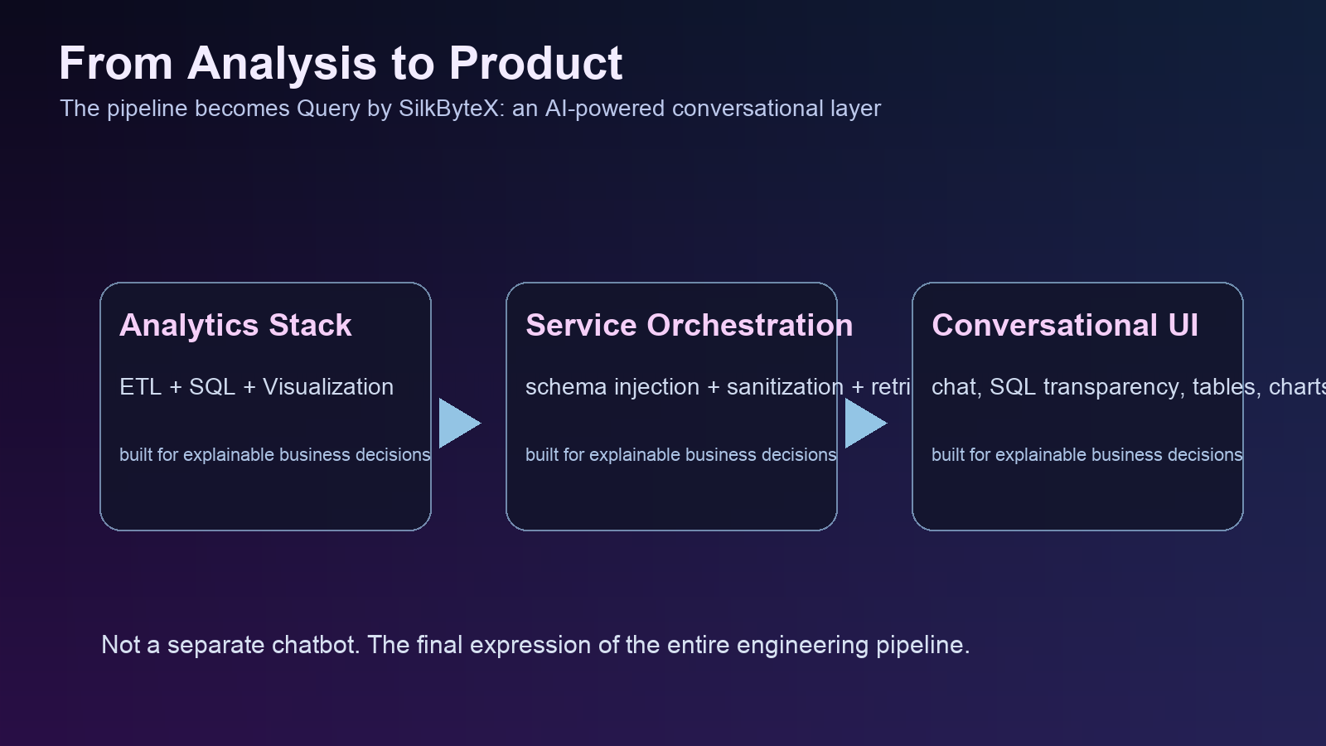
PROJECT HIGHLIGHTS
What Makes The Project Strong
The system combines engineering depth with a usable interface for decision-making.
End-to-End
Scalable
Explainable
Interactive
Full pipeline from raw JSON to business-ready analytics.
Multiple analysis domains: business, user, review, rating, and check-in.
Conversational Text-to-SQL interface on top of a real backend workflow.
Explainable outputs through SQL trace, tables, and chart views.
Data enrichment direction extends the system beyond a single dataset.
From engineering pipeline to user-facing product experience
05

Slide 6
DATA INSIGHTS
Key Insights 1 To 4
Representative insight set drawn from the analysis scope in the project materials.
Business
User
Review
Rating
Merchant concentration is uneven across cities and categories, revealing localized market dominance.
Elite and high-activity users contribute a disproportionate share of review influence.
Text patterns in reviews help explain why star ratings rise or fall, not just what the final score is.
High review volume does not always mean consistently high satisfaction.
Business category mix affects both visibility and rating behavior.
User participation quality matters more than raw activity count alone.
Pain-point language in low-star reviews exposes operational issues hidden by averages.
Comparing categories and cities reveals more than looking at global averages.
06

Slide 7
DATA INSIGHTS
Key Insights 5 To 8
Additional insights connect traffic behavior, timing, and enrichment opportunities.
Check-in
Timing
Enrichment
Decision Support
Check-in activity complements reviews by showing physical demand, not only digital feedback.
Weekday versus weekend patterns can change rating and traffic behavior.
Temporal views help distinguish stable businesses from short-term spikes.
Combining ratings, reviews, and check-ins creates stronger ranking logic than any single metric.
External context such as weather or location conditions can refine internal interpretations.
Cross-validation reduces the risk of drawing conclusions from one source alone.
Conversational querying lowers the barrier for non-technical users to explore these insights.
The product layer turns analysis outputs into reusable decision support.
07

Slide 8
LESSONS LEARNED
What The Team Learned
The project improved both technical depth and collaboration discipline.
Distributed Systems
Analytics
Collaboration
Product Thinking
Clean schema design and data preparation are essential before advanced analytics.
Distributed tools like HDFS, Hive, Spark, and Zeppelin work best as one coordinated workflow.
Reliable analytics products need both backend rigor and frontend clarity.
Team task division helps velocity, but integration quality determines the final result.
AI querying is most valuable when it remains grounded in real schema and real outputs.
Technical learning and product thinking connected across the full journey
08

Slide 9
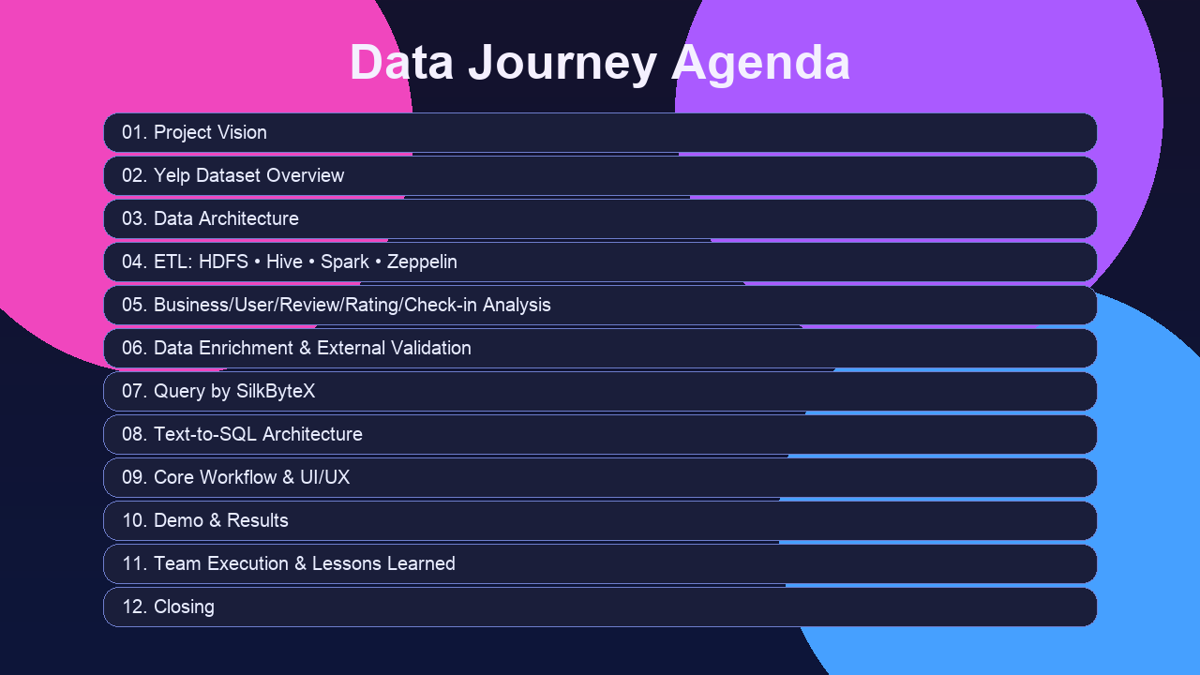
GIT COLLABORATION
Repository And Commit History
Version control was part of the required workflow, but the current workspace snapshot does not include local .git metadata.
GitHub Workflow
Collaboration
Traceability
The provided team deck explicitly documents a GitHub repository overview and commit tracking as part of collaboration.
Repository organization separated analysis modules and supported clearer task ownership.
Git history was used to coordinate revisions and track ongoing progress across modules.
Exact commit counts and per-member commit statistics are not recoverable from this exported workspace because no .git directory is present.
Collaboration rhythm and versioned project progress
09

Slide 10
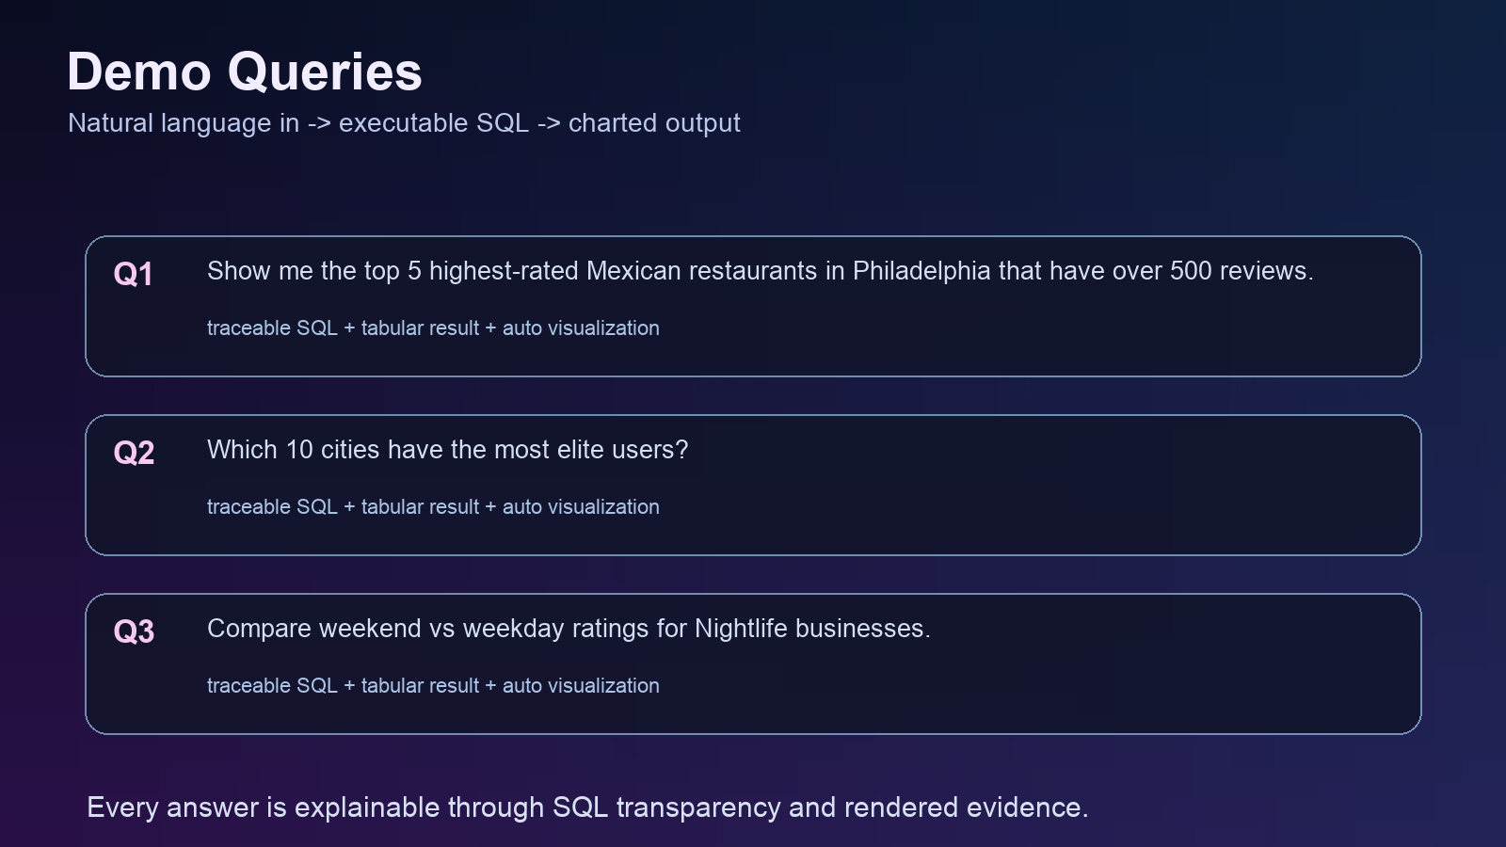
CLOSING
From Raw Data To Conversational Intelligence
A compact summary of the project’s engineering value and presentation-ready outcome.
ETL
Analytics
Insights
AI Product
Built a real big data workflow, not isolated scripts.
Generated actionable insight across multiple analytical domains.
Translated the backend pipeline into a user-facing conversational product.
Delivered a presentation-ready system with clear ownership, architecture, and lessons learned.
The final system turns questions into explainable outputs
10

